Slide 1
Applications of Information and Communication Technologies
Rabail Asghar
Lecturer (Computer Science)
COMSATS University Islamabad, Lahore Campus

Slide 2
Topics to cover
Control Flow Statements

Slide 3
Control Flow Statements
The statements inside your source files are generally executed from top to bottom, in the order that they appear. Control flow statements, however, break up the flow of execution by employing decision making/conditioning, looping, and transferring control, enabling your program to execute particular blocks of code.

Slide 4
Control Flow Statements
The control flow statements are divided into three parts:-
Conditional statements
Iterative statements
Transfer statements

Slide 5
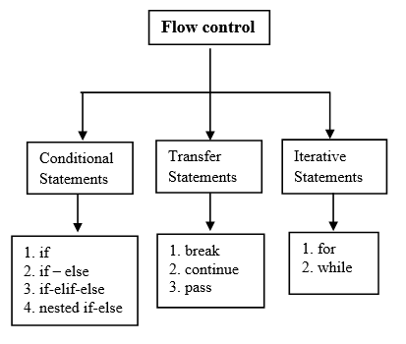
Control Flow Statements

Slide 6
Transfer statements
These are typically used within loops (for and while) to control how the loop behaves under specific conditions.
They are used to transfer control from one part of the program to another.
break
continue
pass

Slide 7
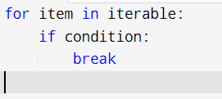
break Statement
The break statement is used to terminate the loop prematurely when a specific condition is met.
Control moves to the statement following the loop.
Syntax:

Slide 8
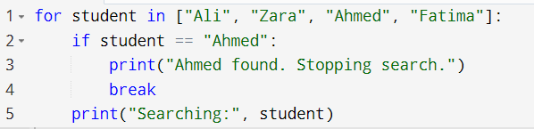
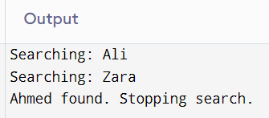
Example- searching name

Slide 9
break Statement
Use Case:
Efficient when searching for a value — it avoids unnecessary iterations after the result is found.

Slide 10

continue statement
The continue statement is used to skip the remaining code inside a loop for the current iteration only.
Syntax:

Slide 11
continue statement
Use Case:
Useful when certain values need to be skipped or ignored during iteration.

Slide 12
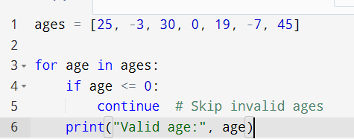
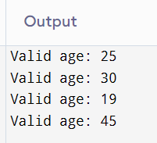
Example: Skipping Invalid Entries During Data Input
Scenario:
process a list of user-entered ages. If any age is negative or zero, it's invalid and should be skipped.

Slide 13

pass statement
The pass statement does nothing. It is a null statement used as a placeholder when a statement is syntactically required but is intentionally left empty for future implementation.
So the pass statement allows the code to run without errors.
It is different from a comment, which is ignored by the interpreter, while pass is a valid statement that does nothing.
This is particularly useful in situations like defining empty functions, classes, or control flow structures where the implementation will be added later.

Slide 14
Example: Handling Special Cases with pass in a Loop
Scenario:
You're checking a list of students. If a student is on probation, you want to skip any action for now but still keep the program running without errors.

Slide 15
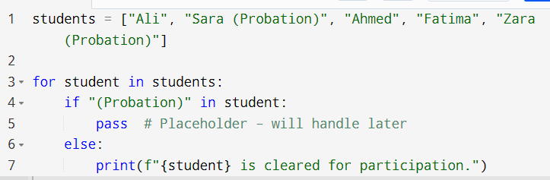
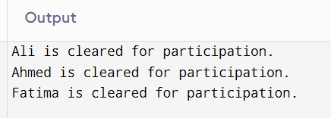
Example: Handling Special Cases with pass in a Loop

Slide 16
Practice
Create a scenario and combine all three statements in one loop.

